Slide 1
Glass Beaker Reconstruction
Alice Martin

Slide 2
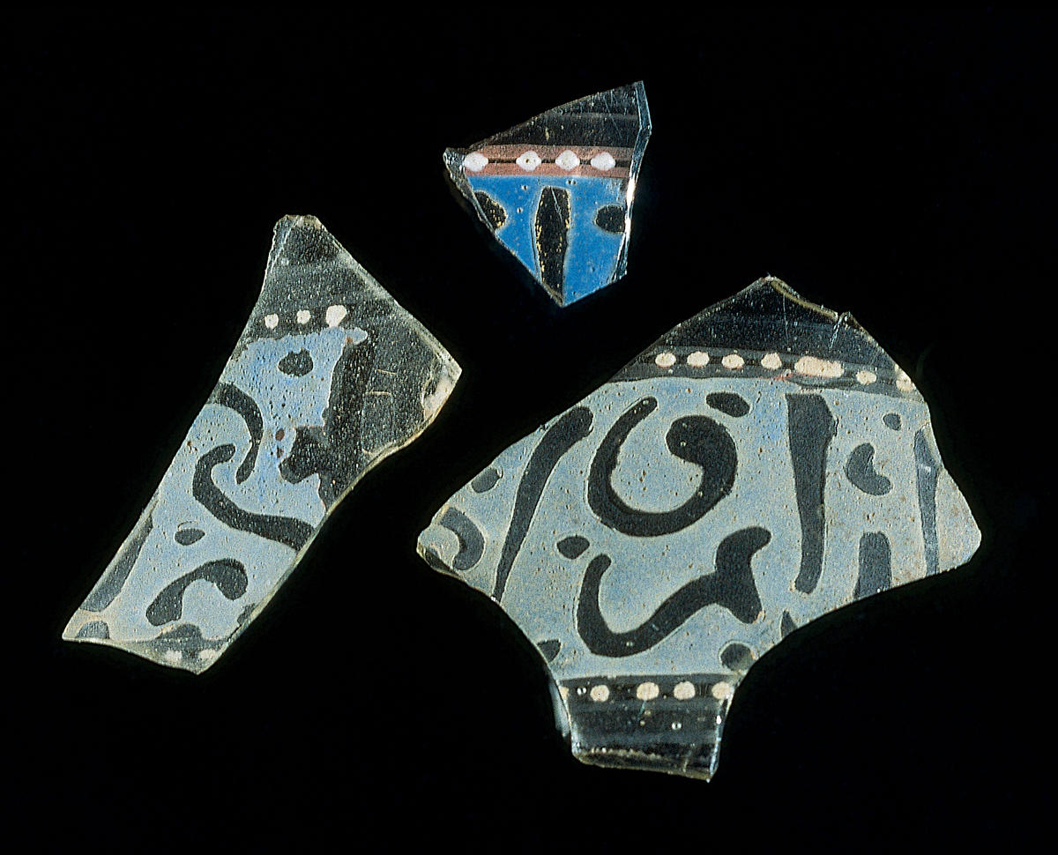
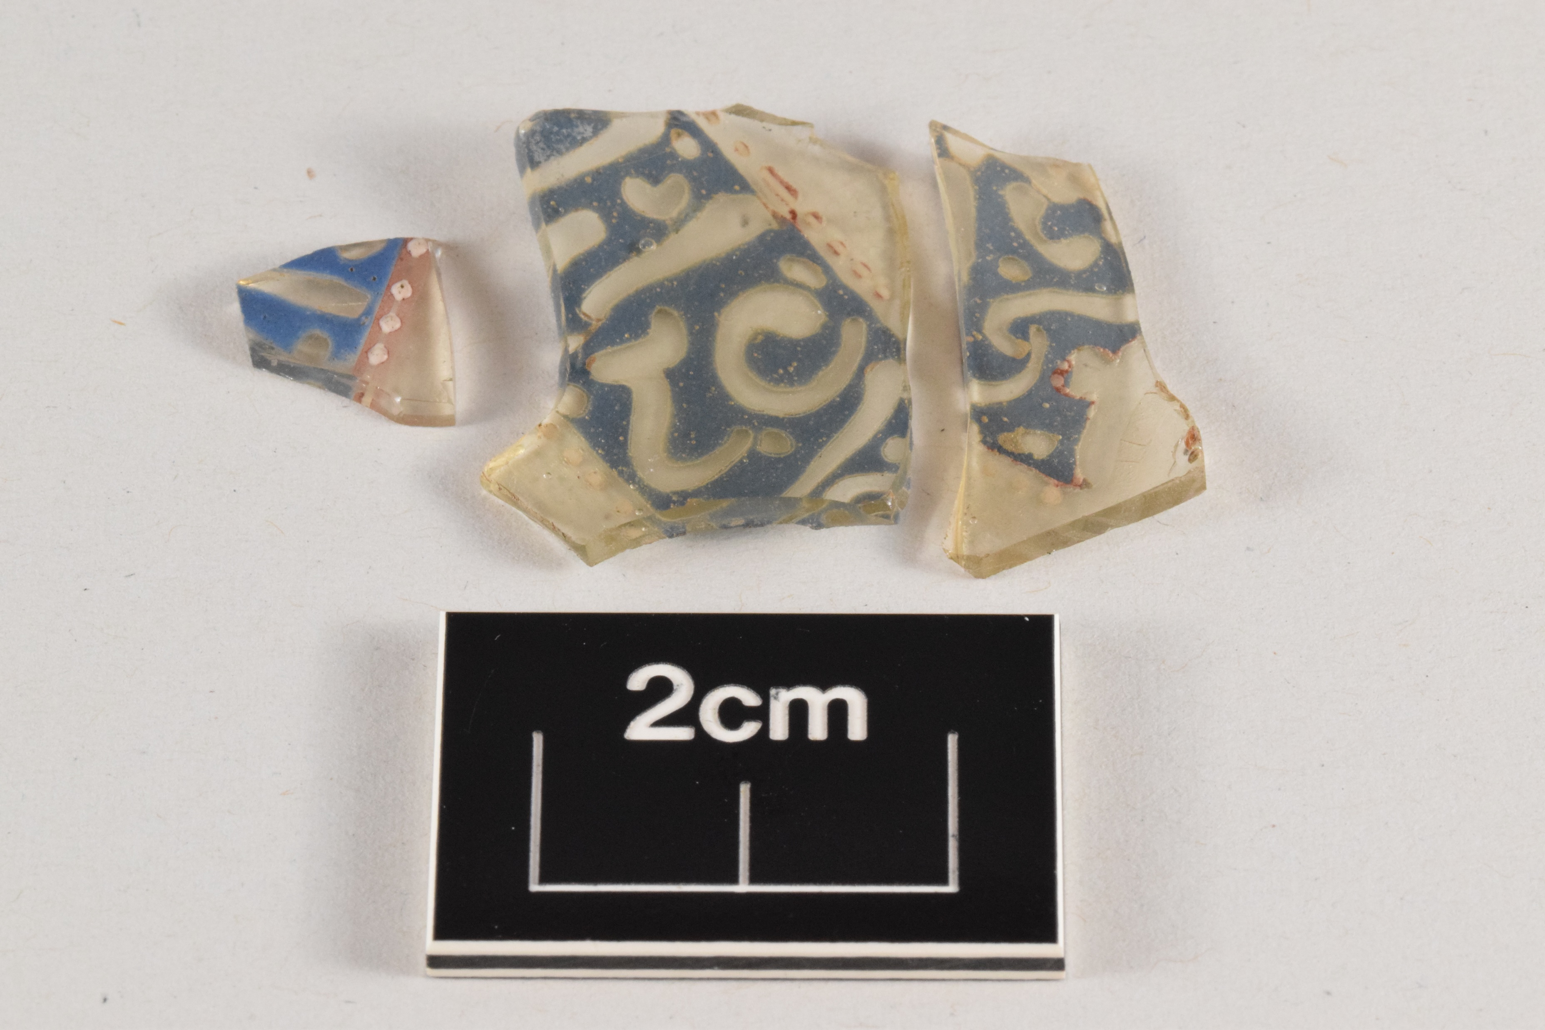
Original Fragments

Slide 3
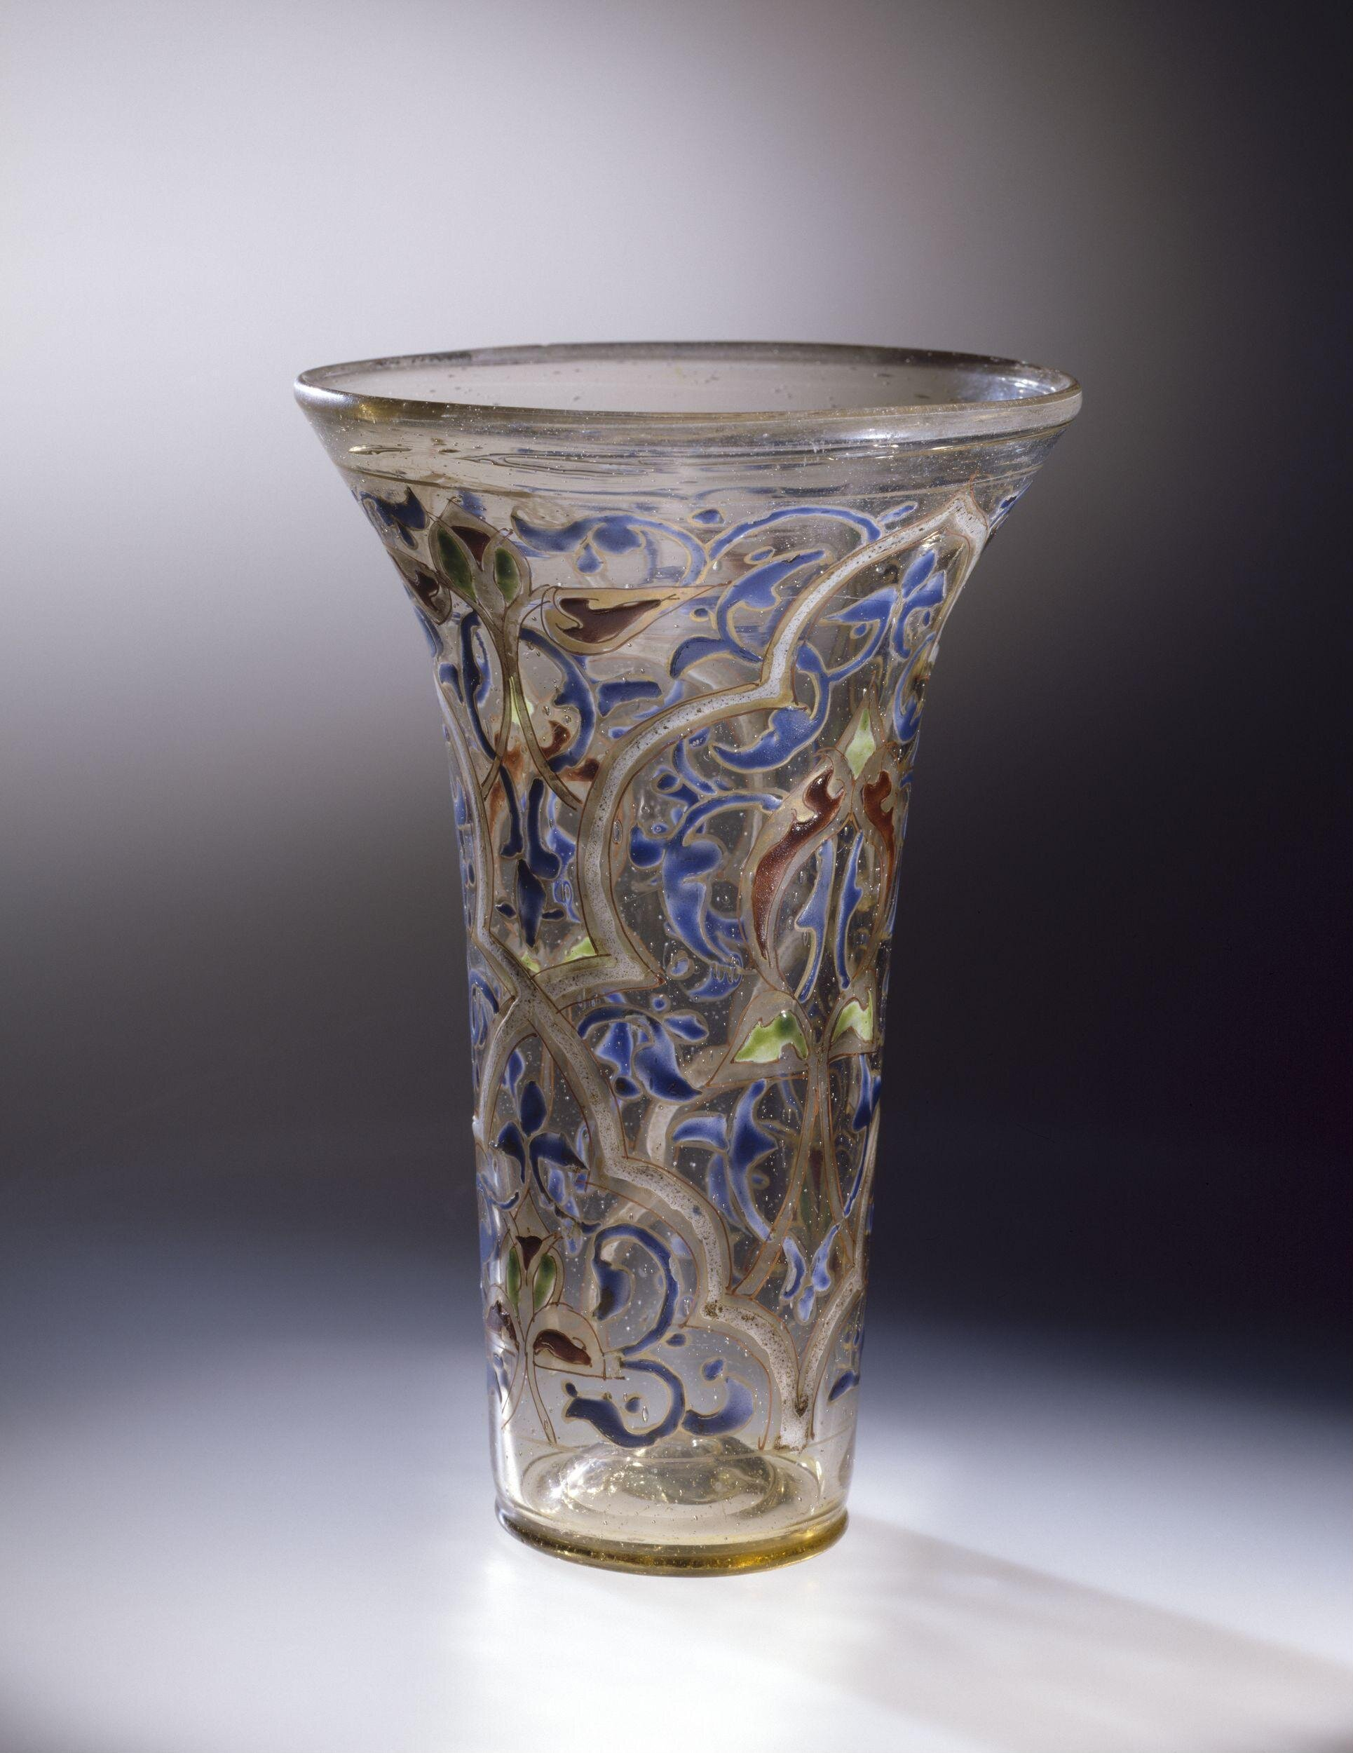
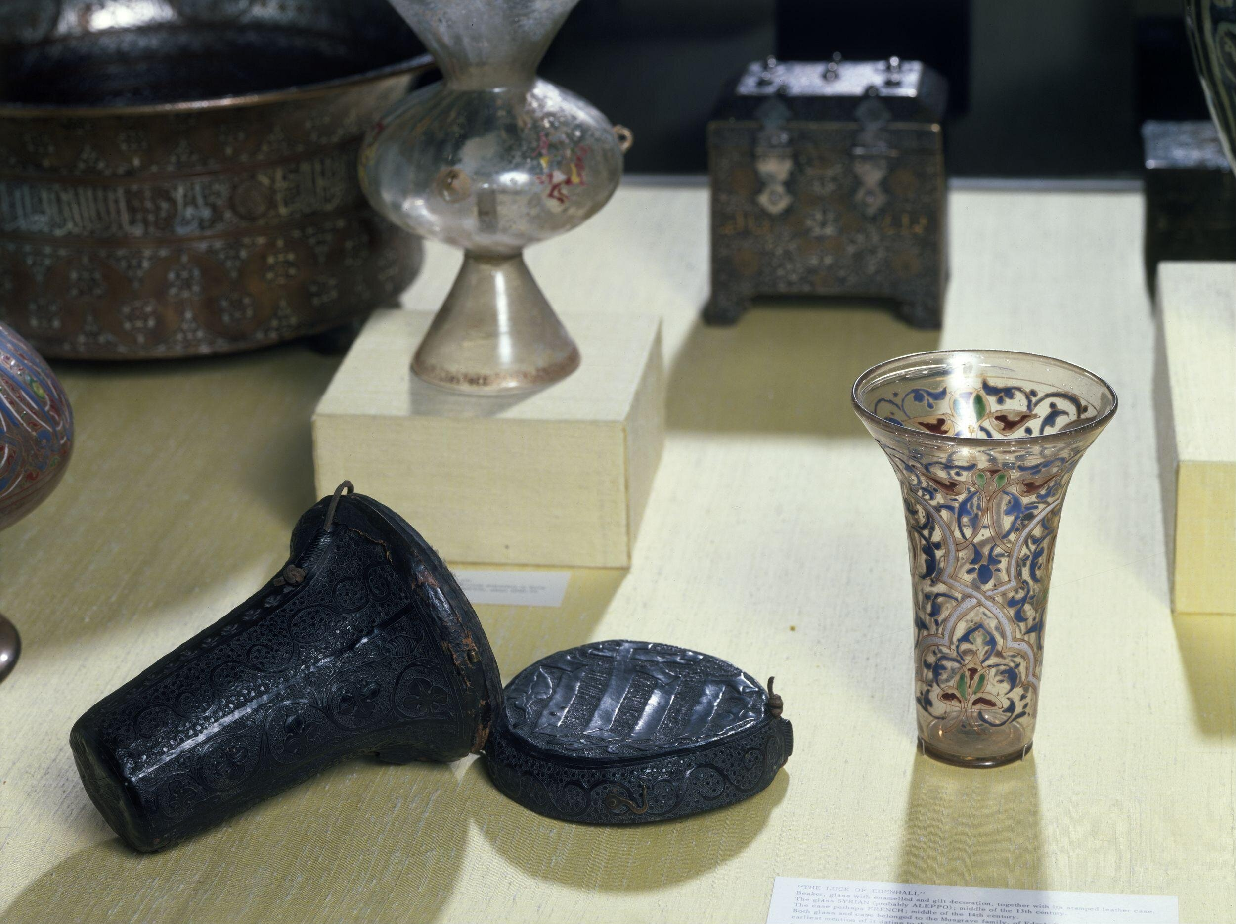
Similar Examples
The Luck of Edenhall
© Victoria and Albert Museum, London

Slide 4
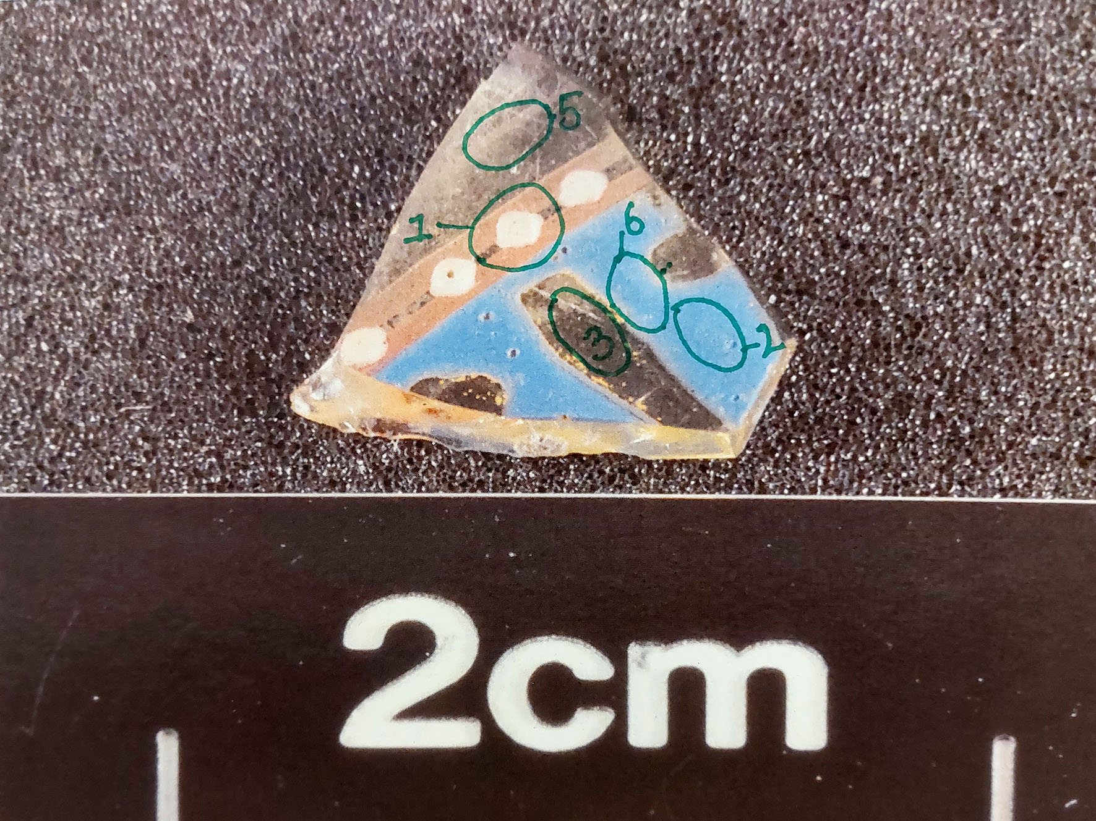
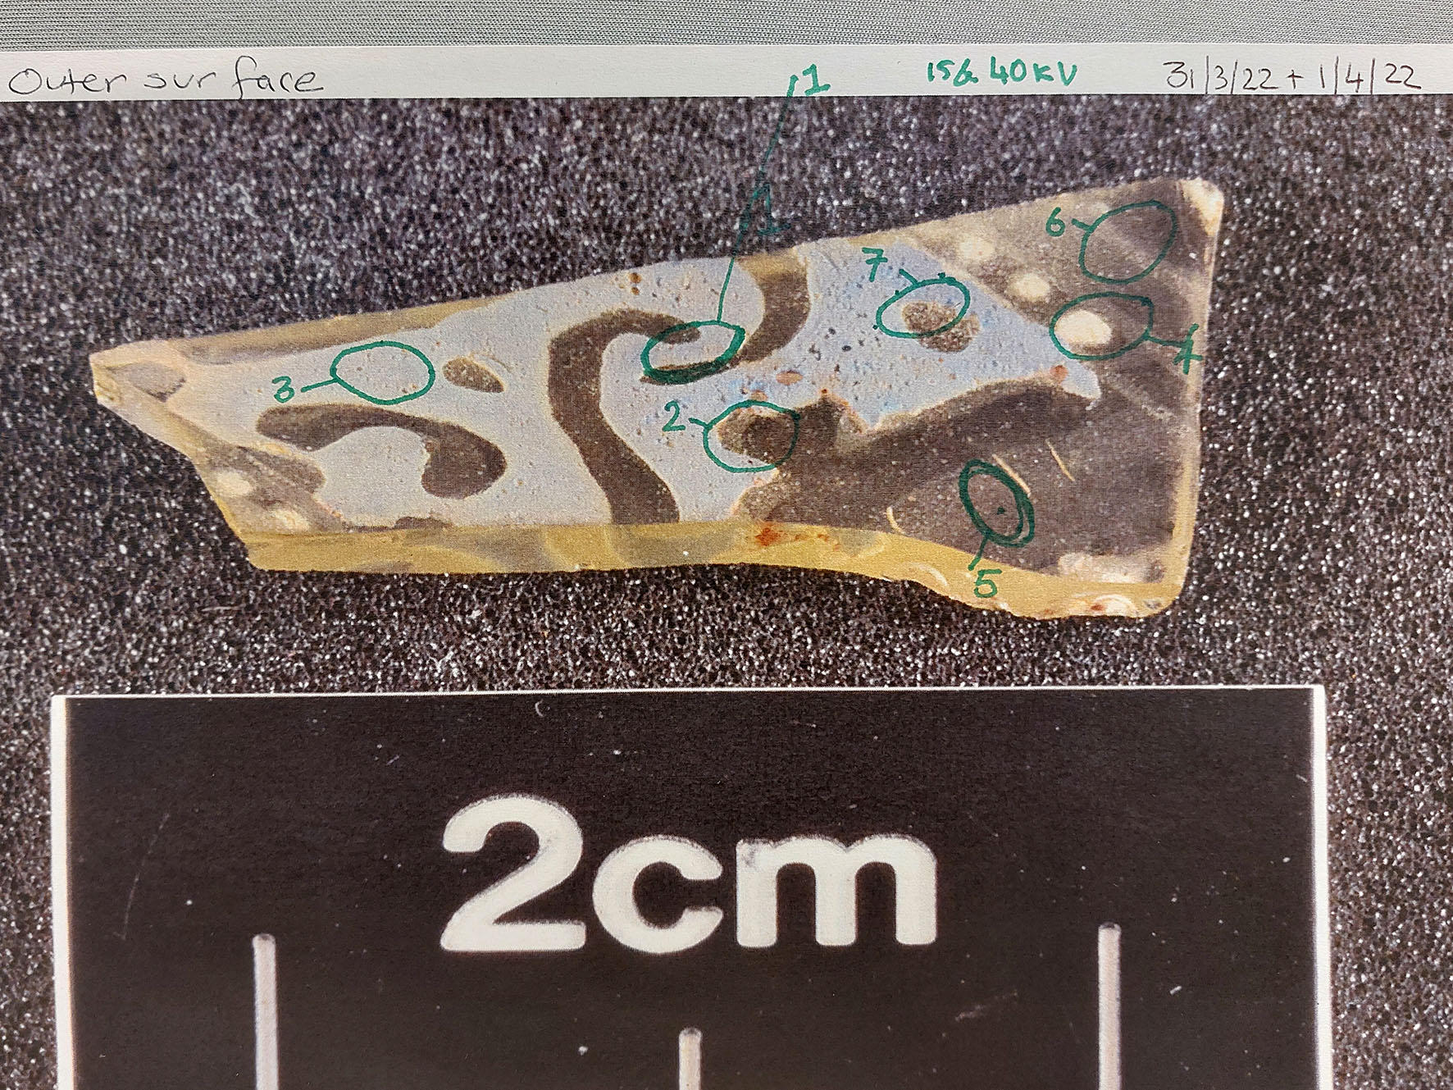
Some areas that were tested

Slide 5
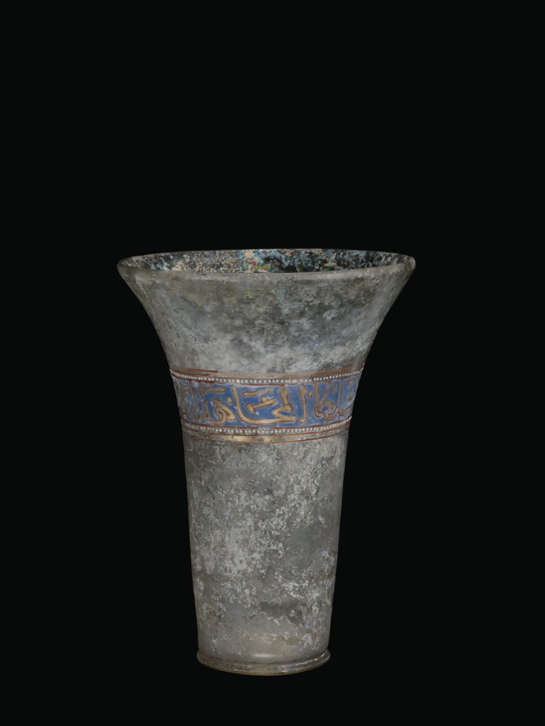
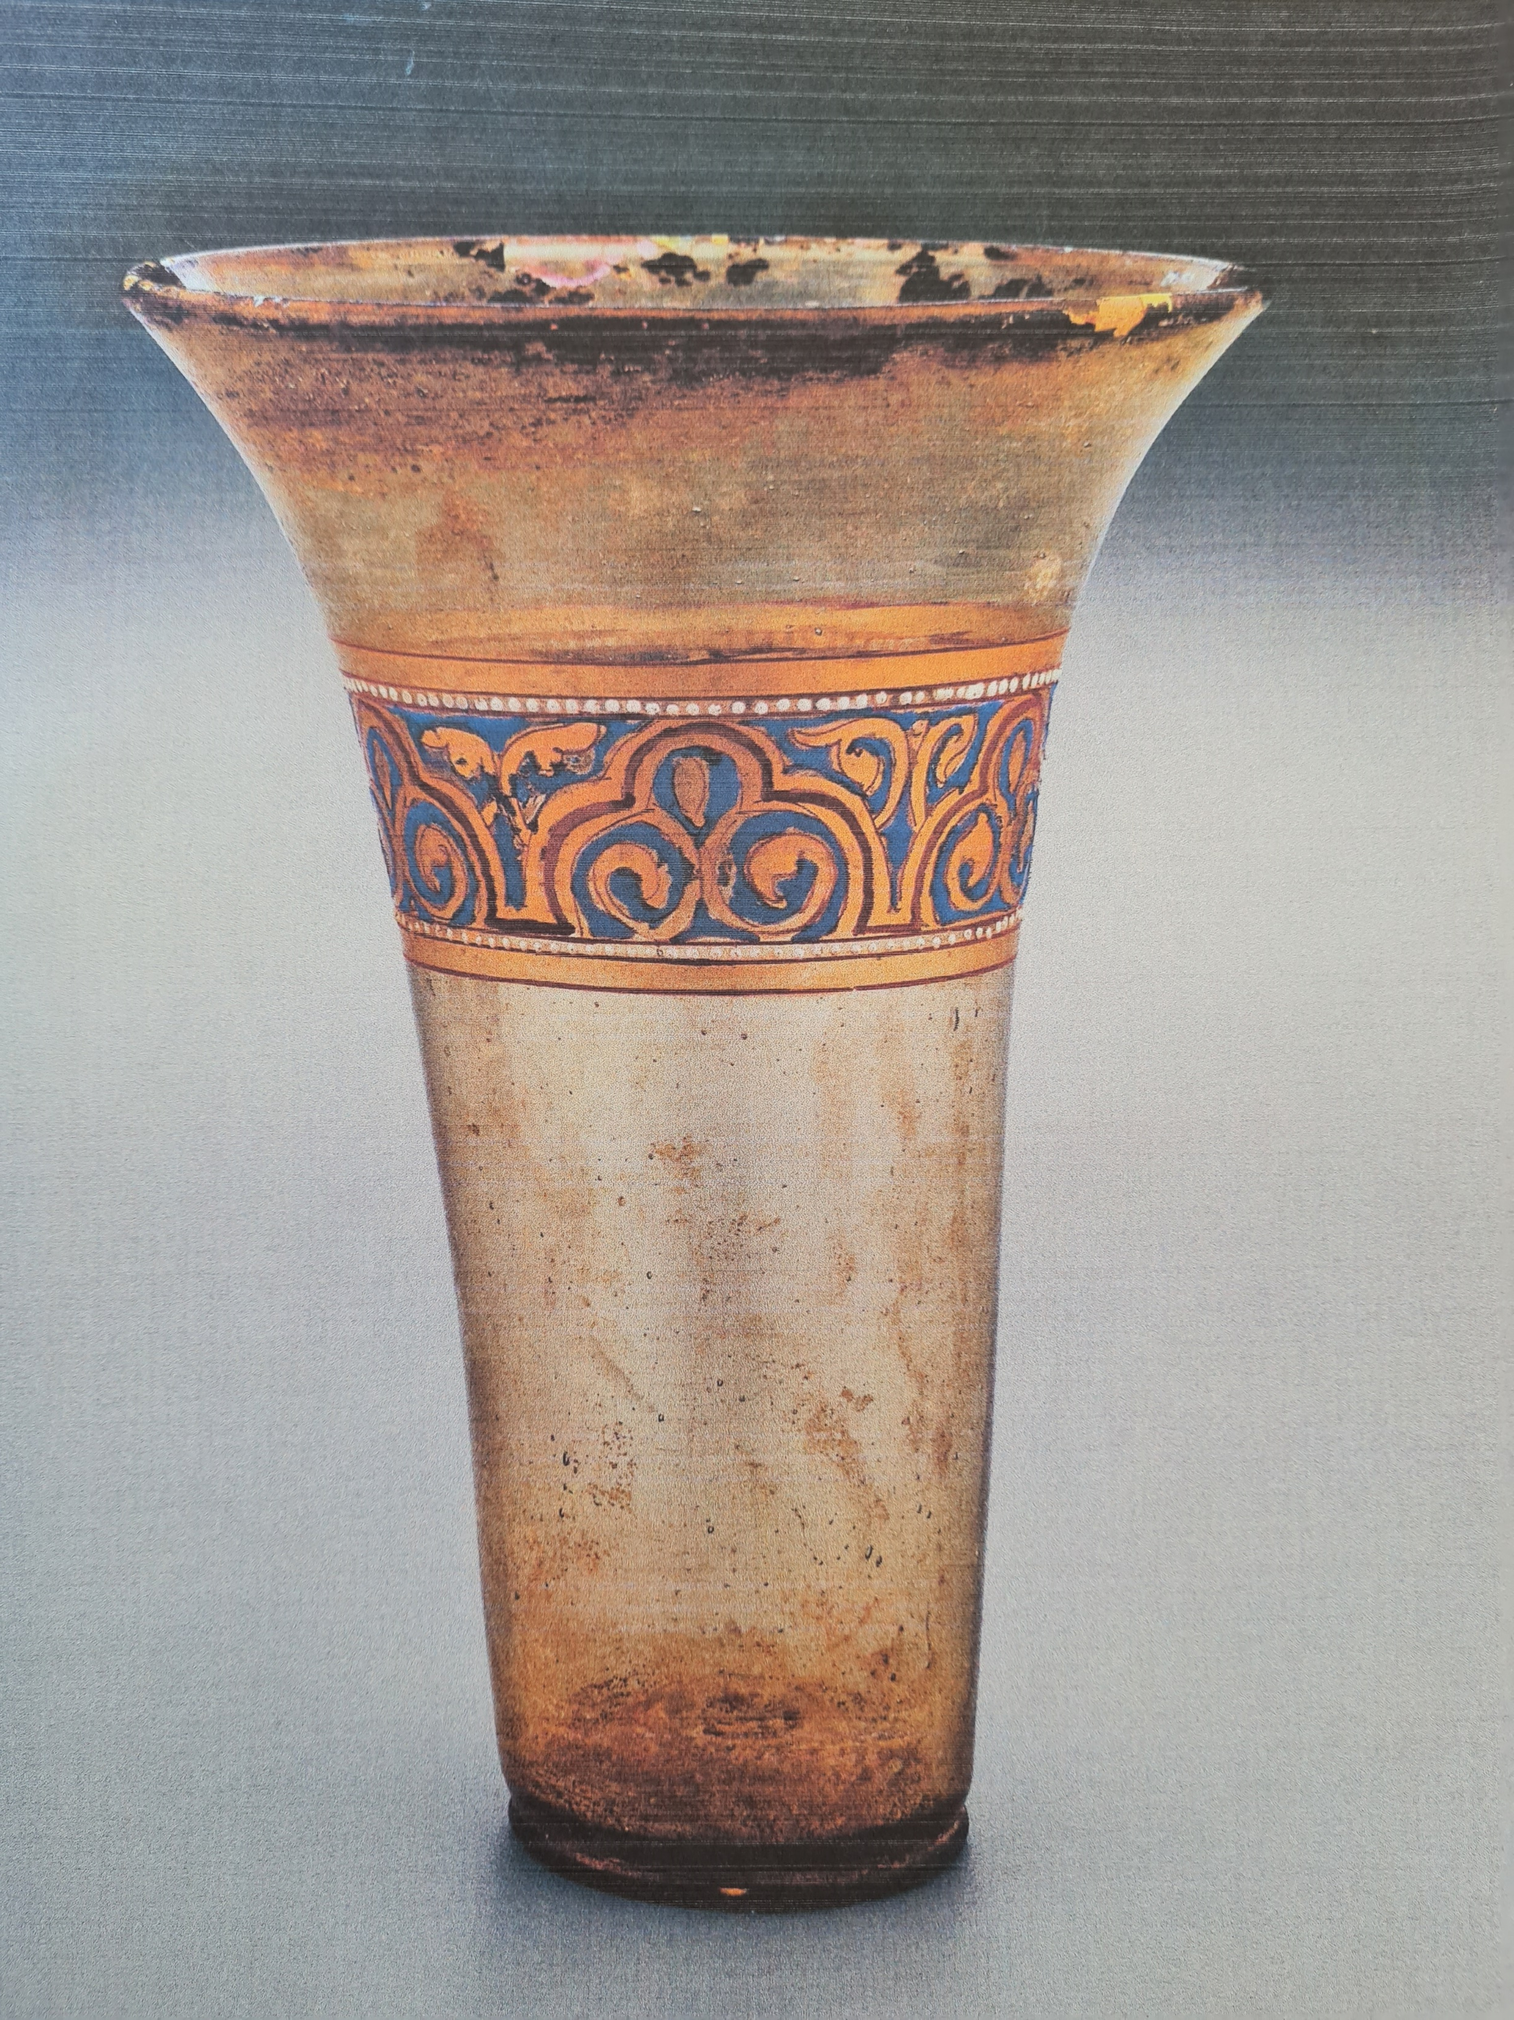
https://www.cmog.org/artwork/beaker-105?image=0&search=collection
%3A9785143f6e08462d6c3a7364a4c46b80&page=1437

Slide 6
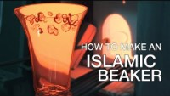
How to make an Islamic beaker
https://www.youtube.com/watch?v=DHloIr_mEEM

Slide 7
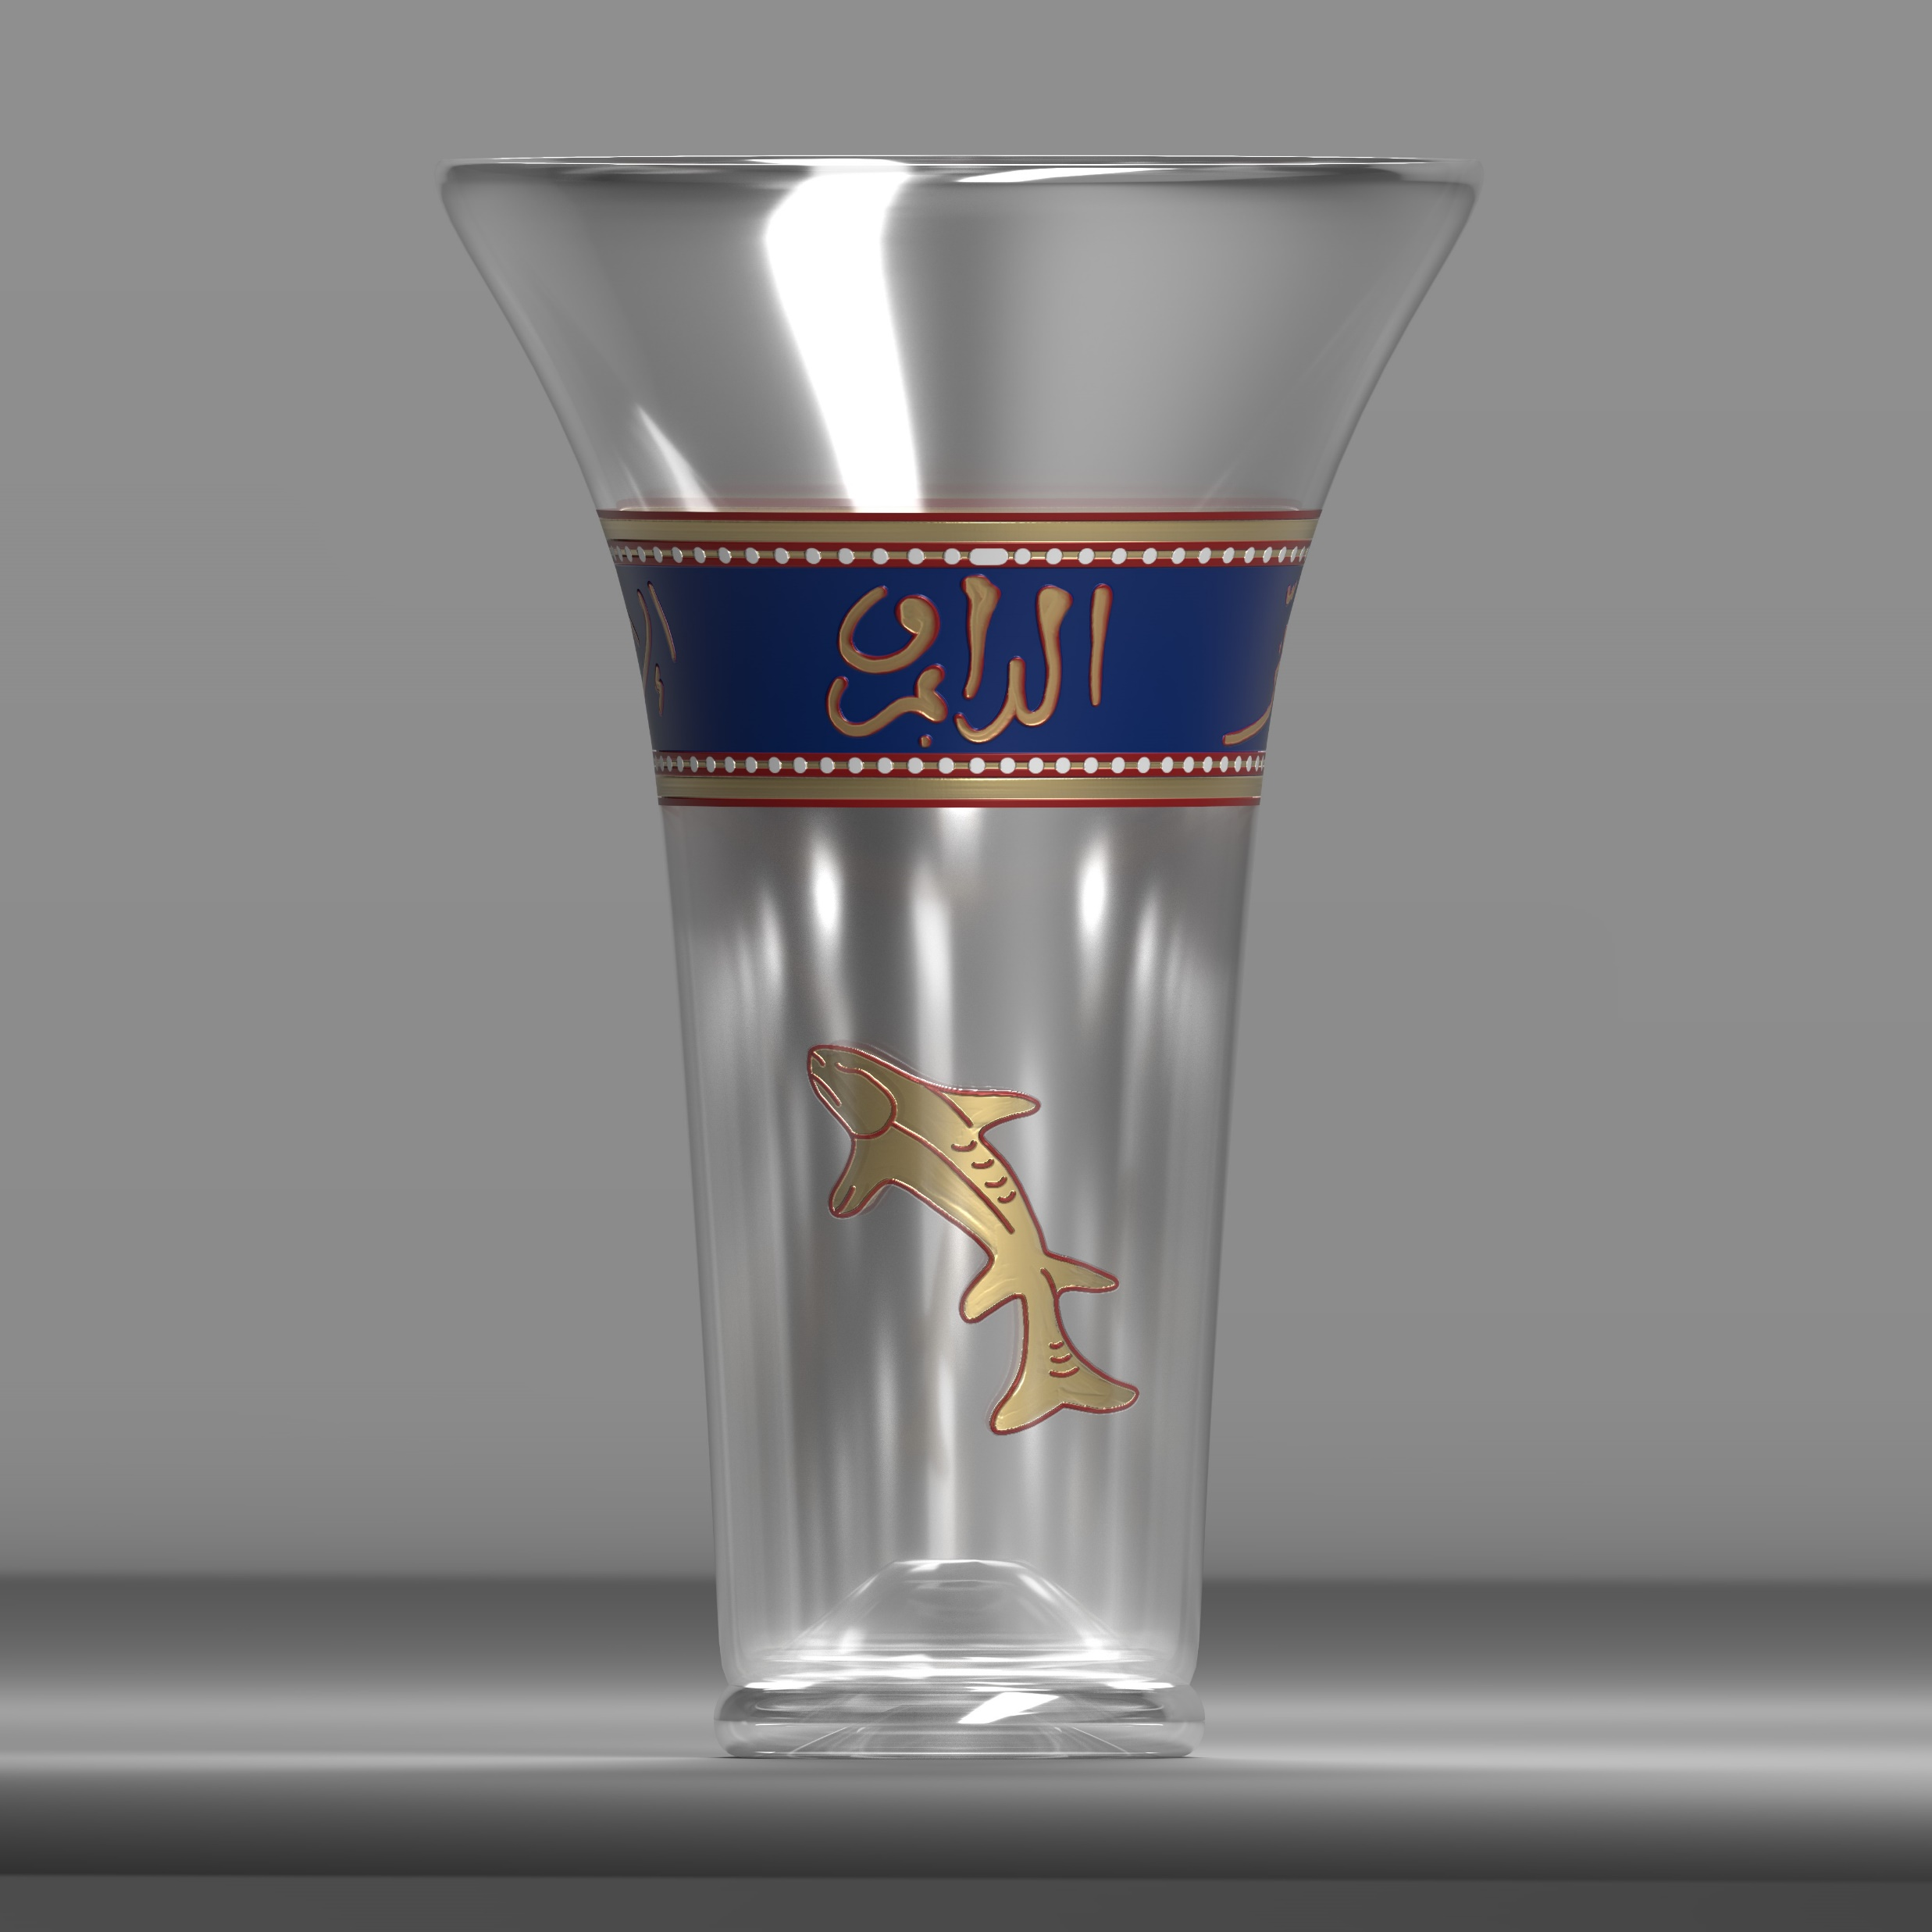
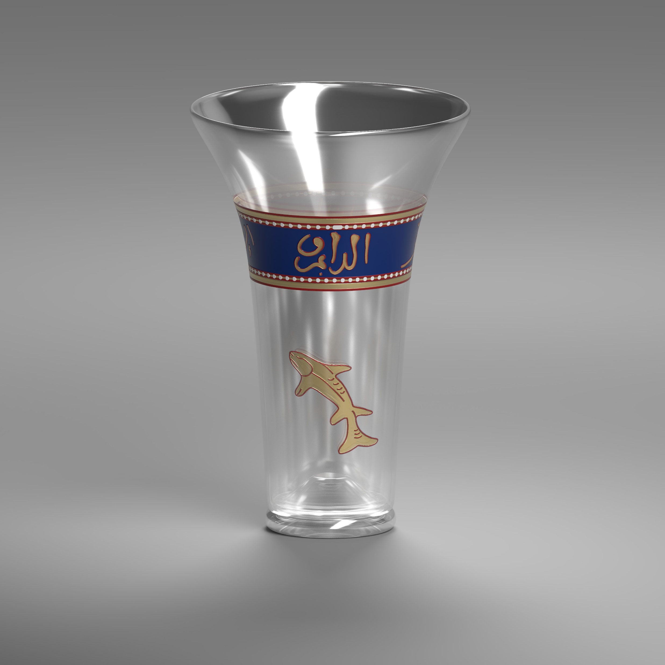
Reconstruction

Slide 8
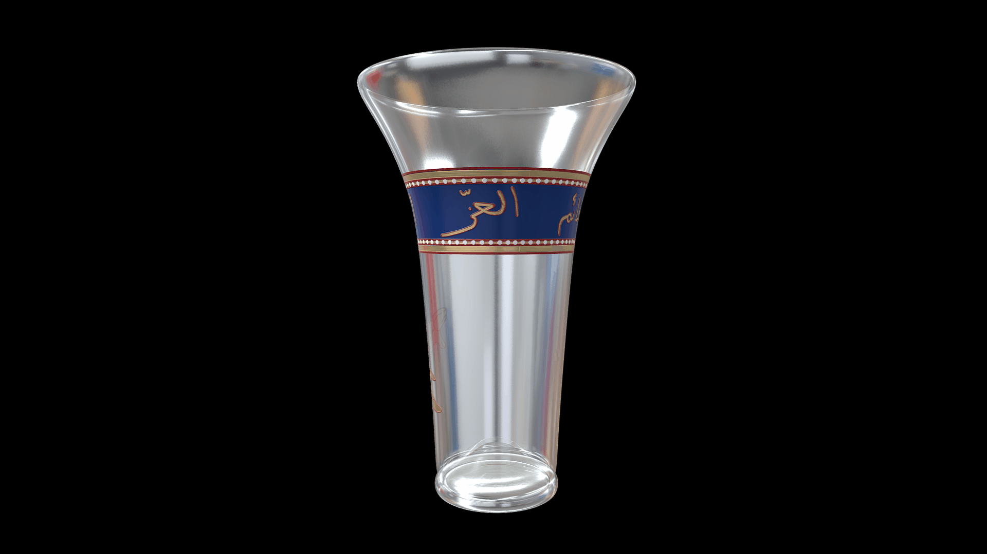
3D Model

Slide 9
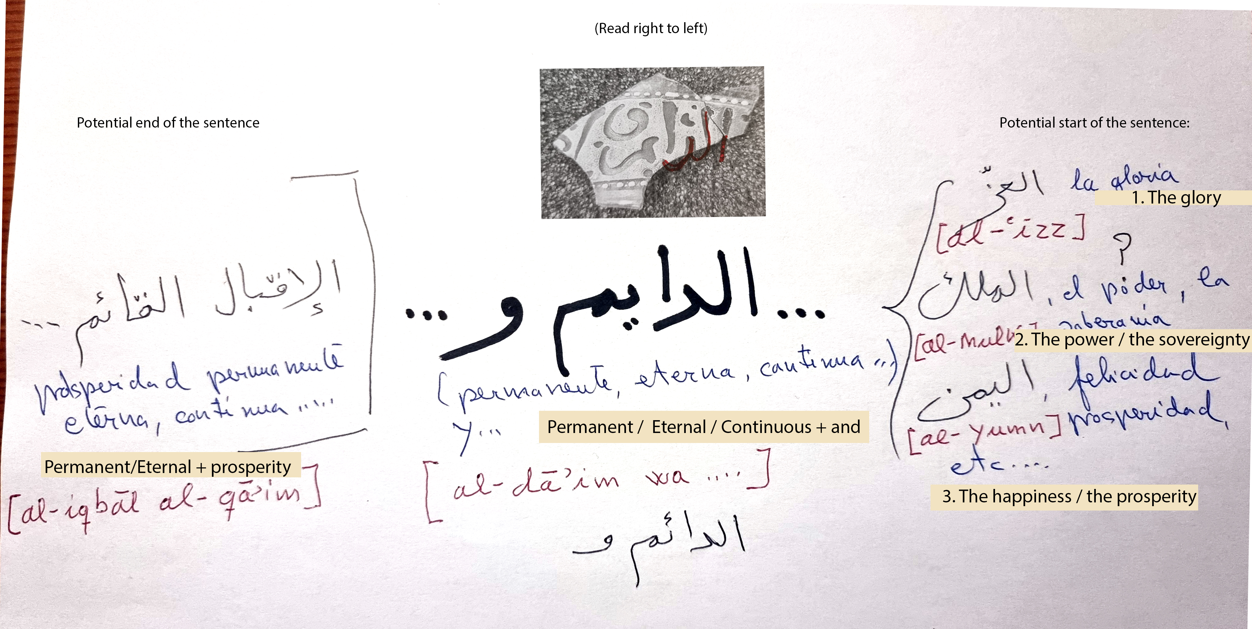
Calligraphy Ideas

Slide 10
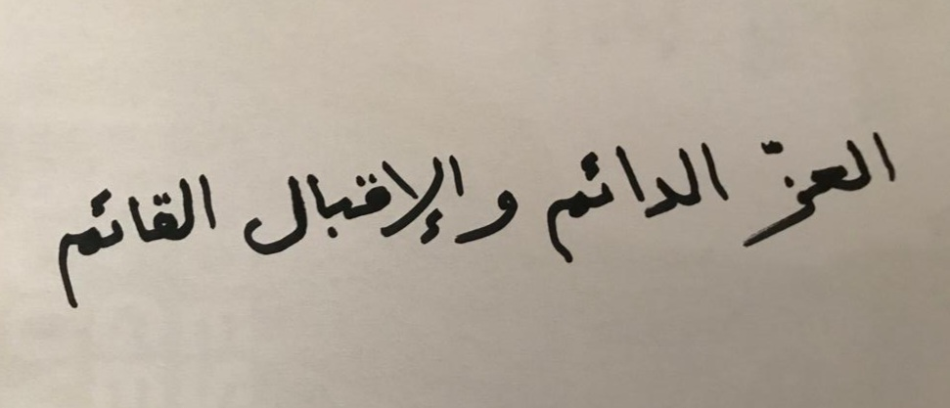
Glory Eternal and Prosperity Permanent

Slide 11
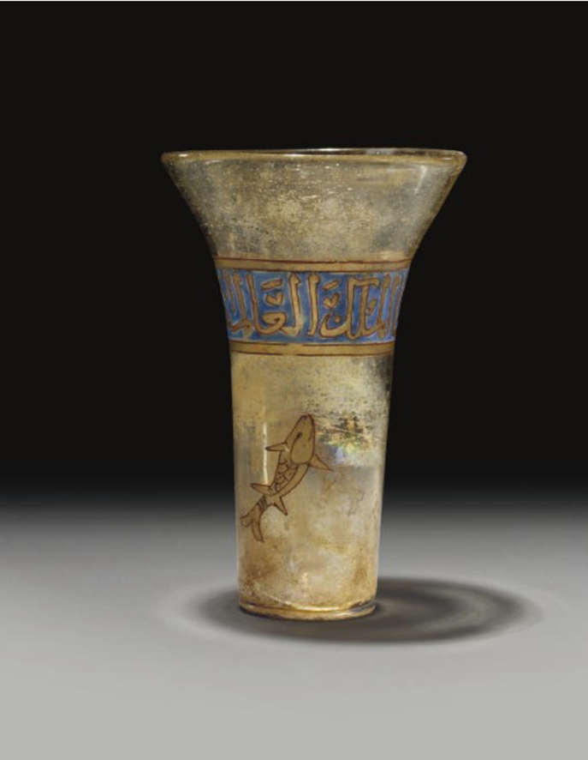
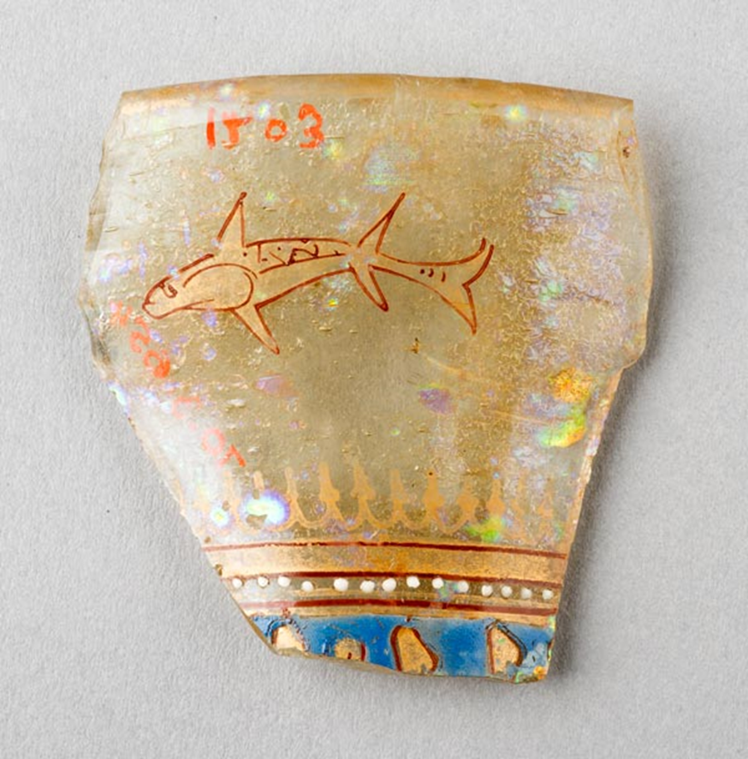
Fish Imagery Examples
© CHRISTIE'S 2022
https://exhibitions.kelsey.lsa.umich.edu/pearls/objects/fish2.html

Slide 12
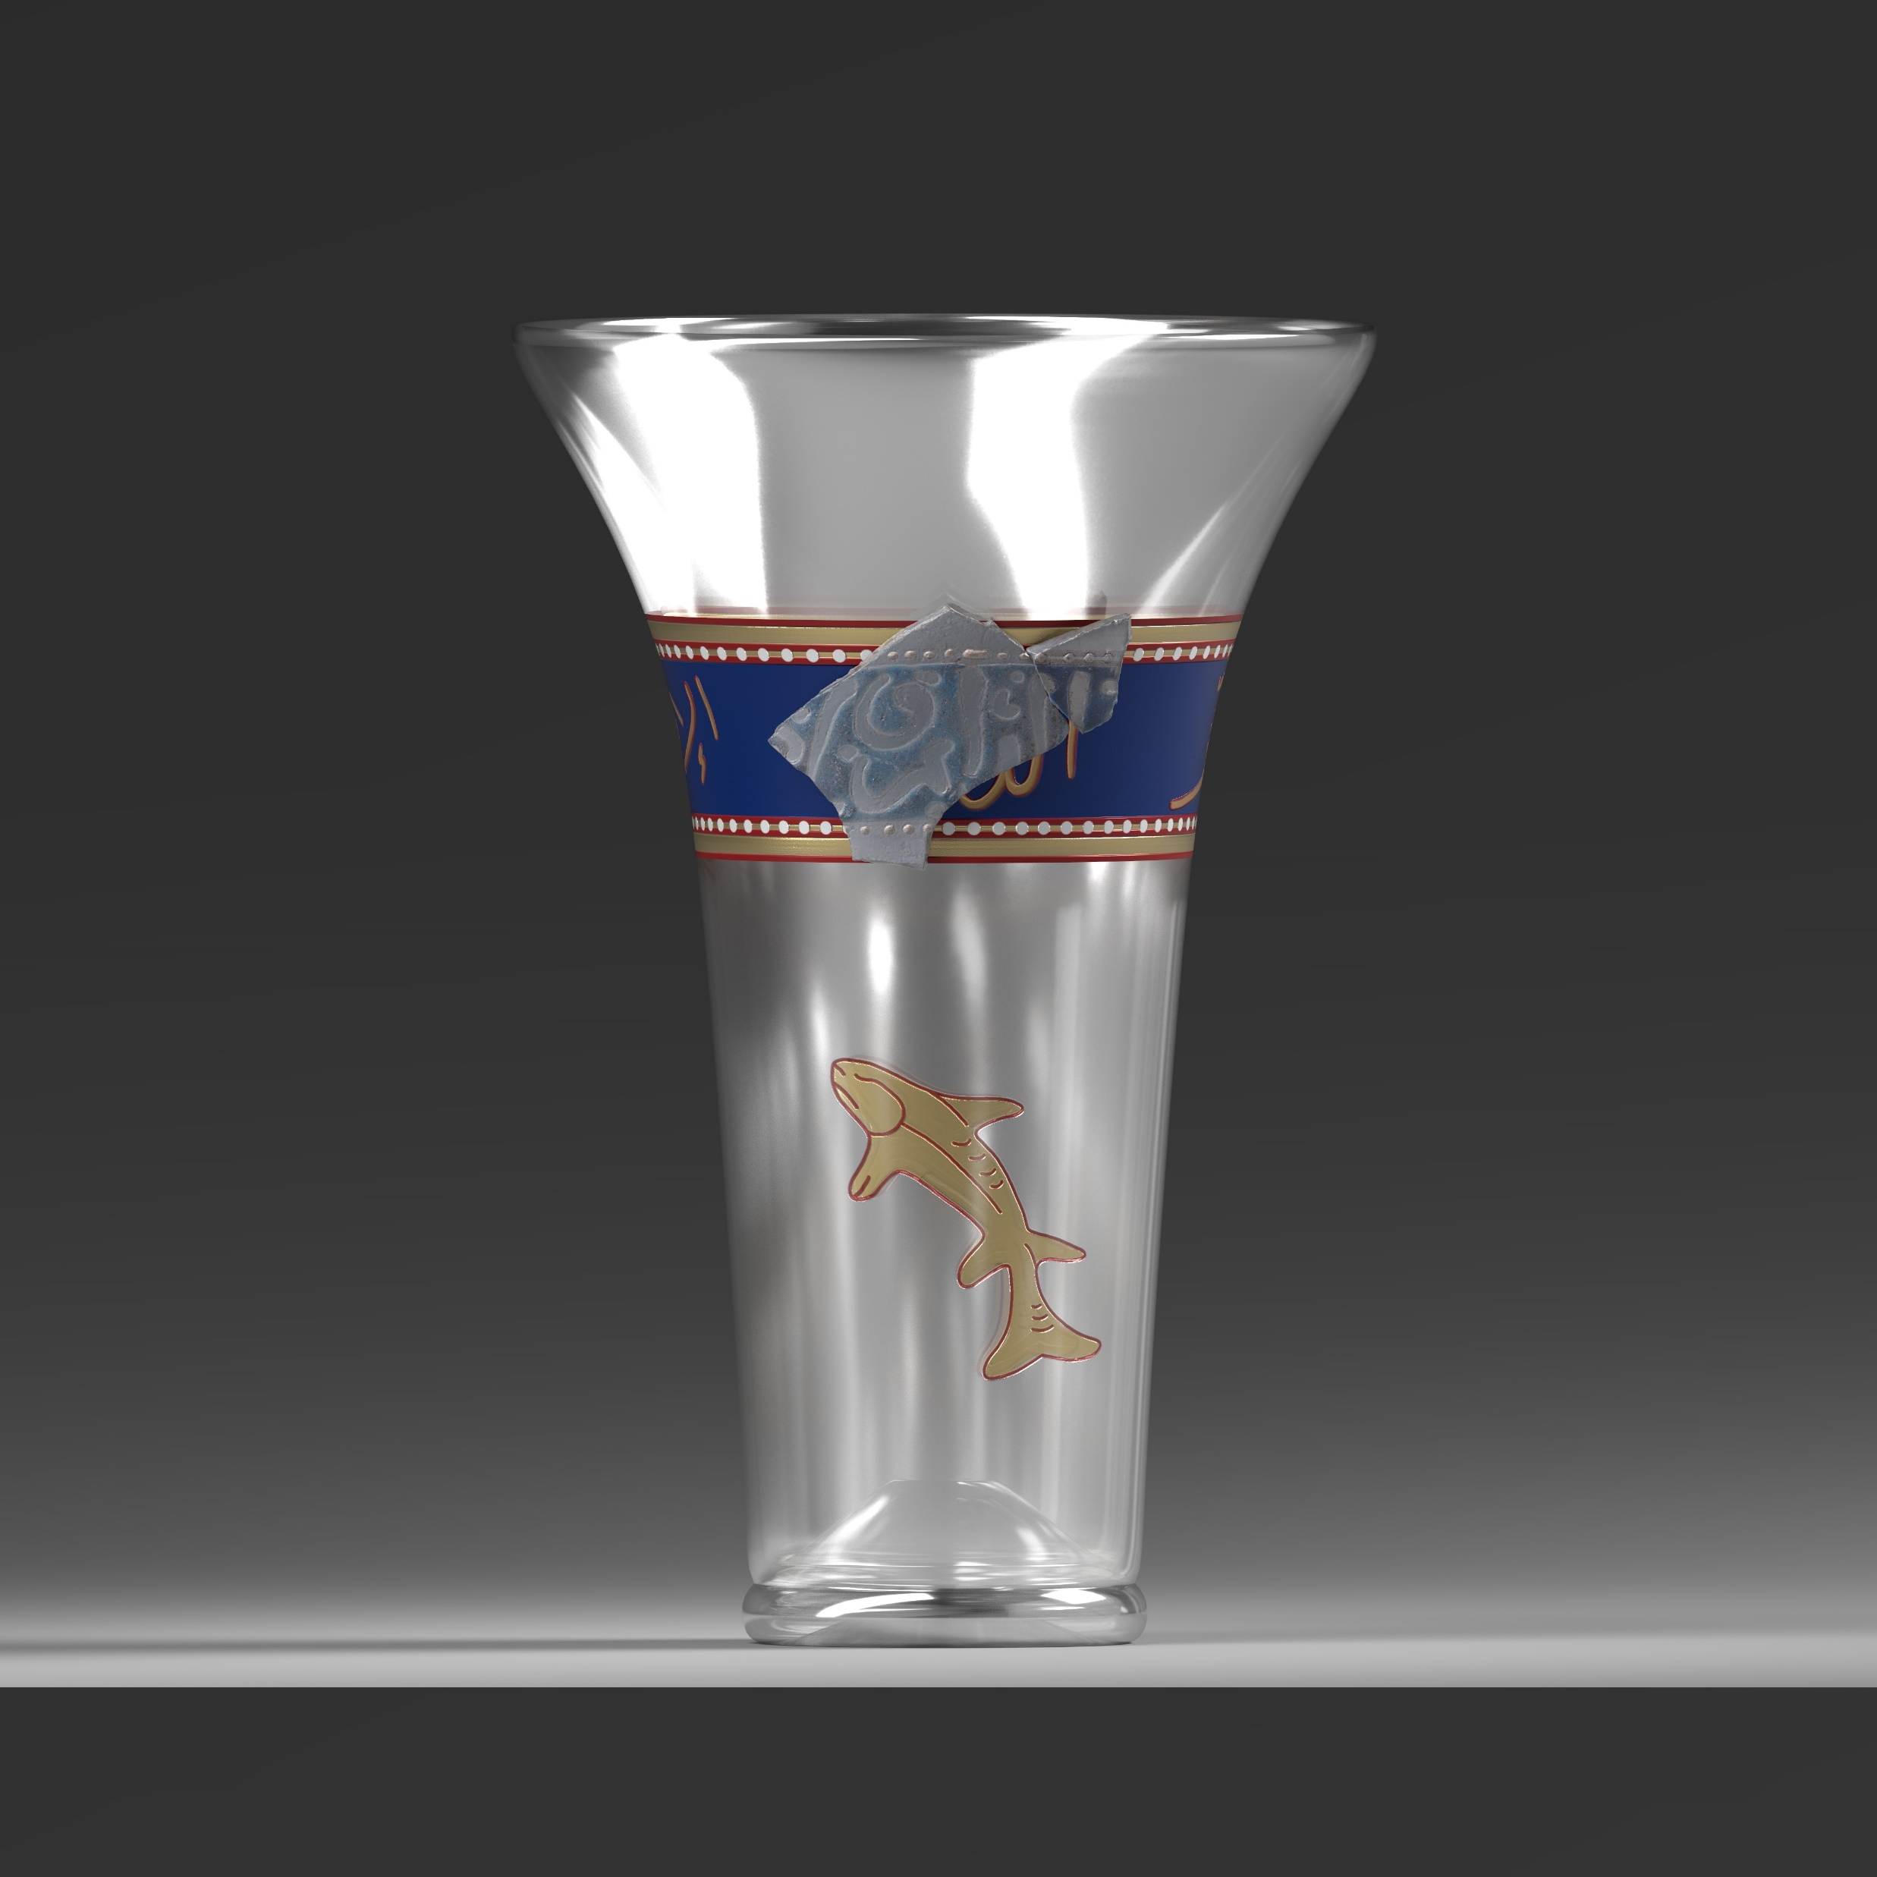
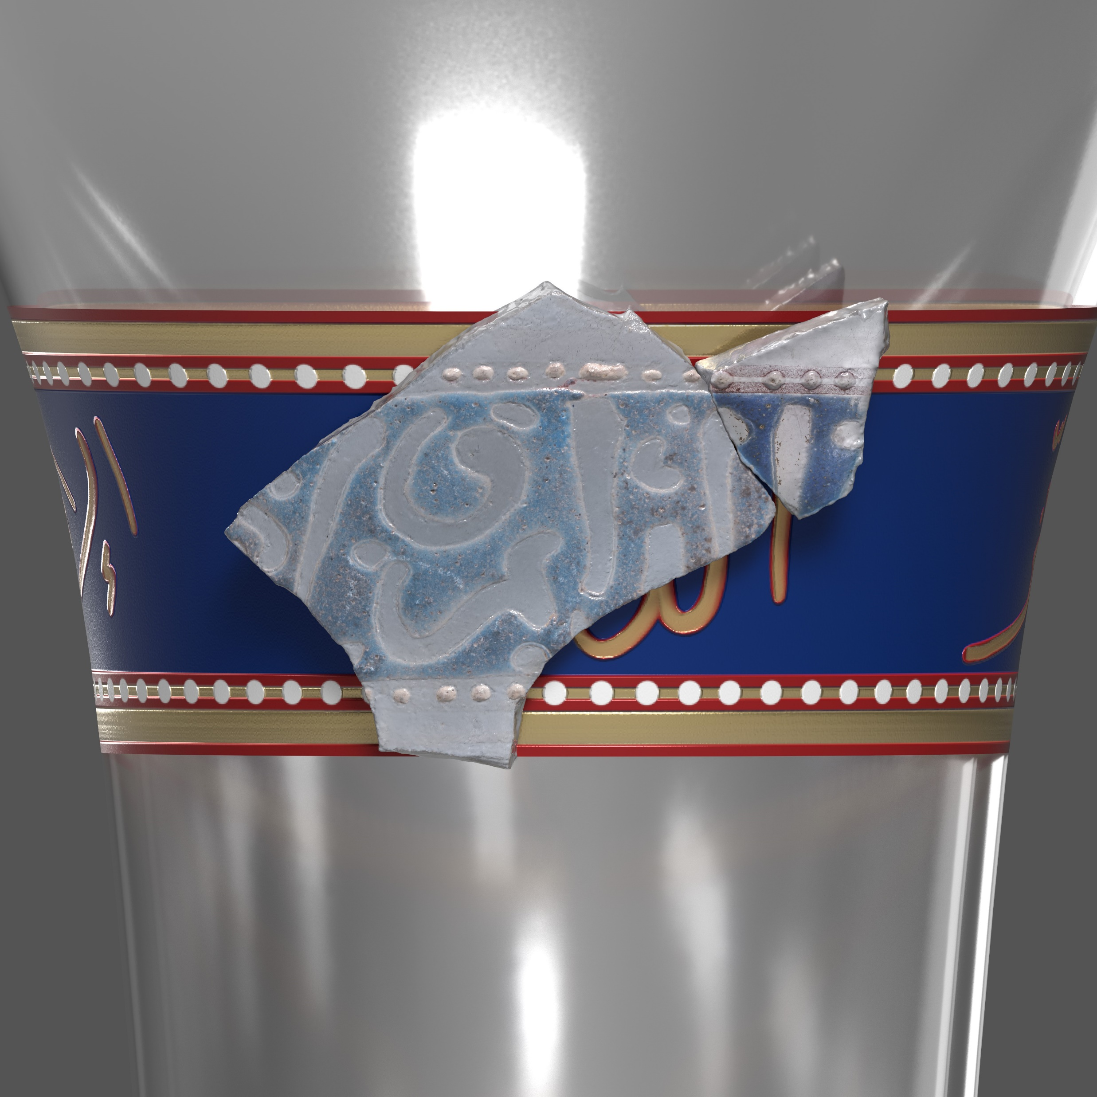
Reconstruction with Original Fragments

Slide 13
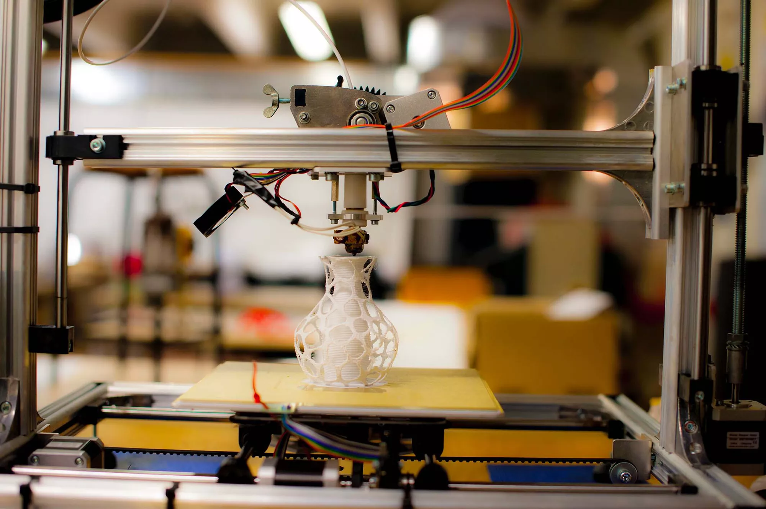
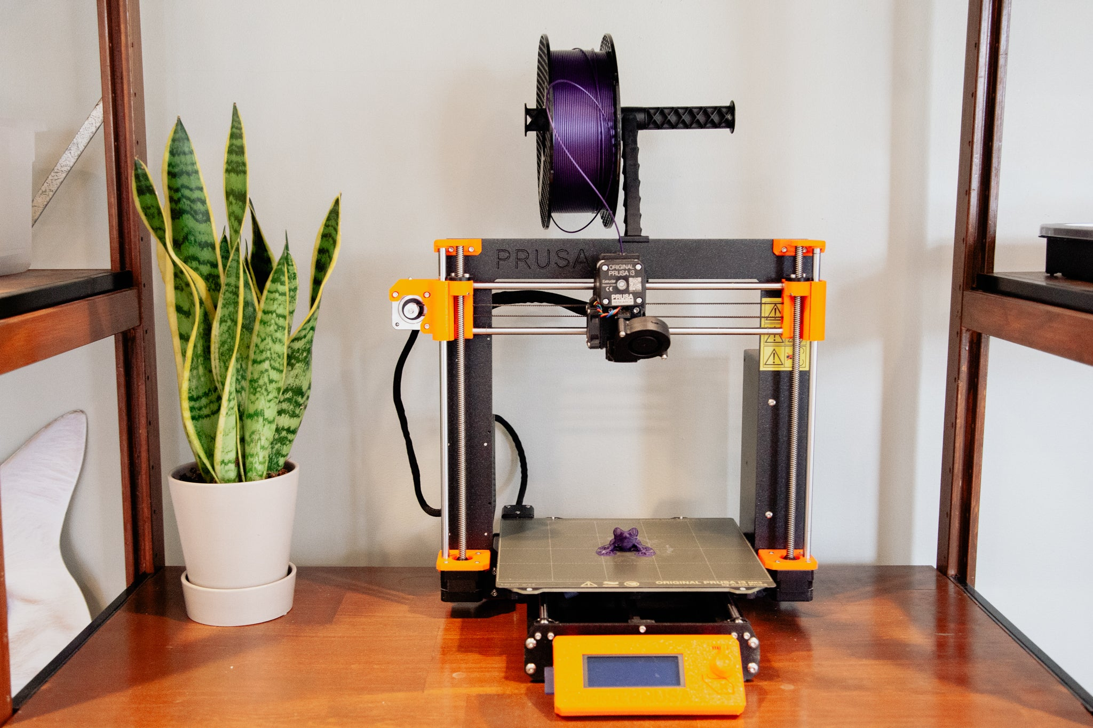
Creative Activity
Marco Vacca / Getty Images
Photo: Signe Brewster

Slide 14
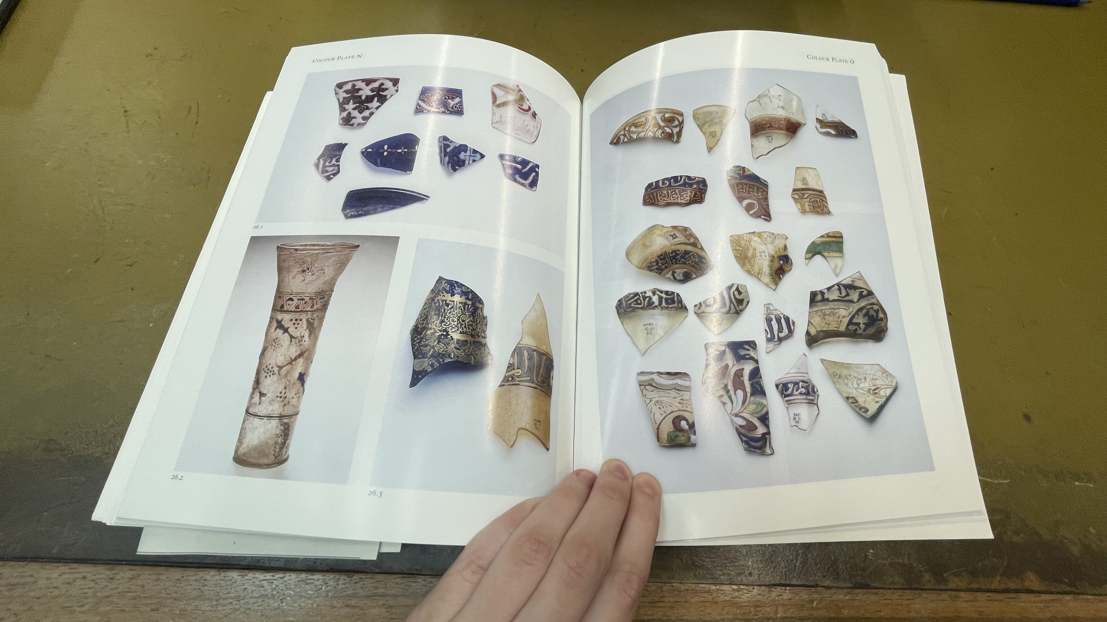
Title: Gilded and enamelled glass from the Middle East /
Author: Ward, Rachel.

